Slide 1
Describing Language

Slide 2
Speech
Today we are going to talk about talking.

Slide 3
Speech
Acoustics – study of the physical properties of sounds
Sound spectrogram – amount of energy present in a sound when frequency is plotted against time
Formants – peak energies in a spectrogram
Especially helps us understand vowels

Slide 4
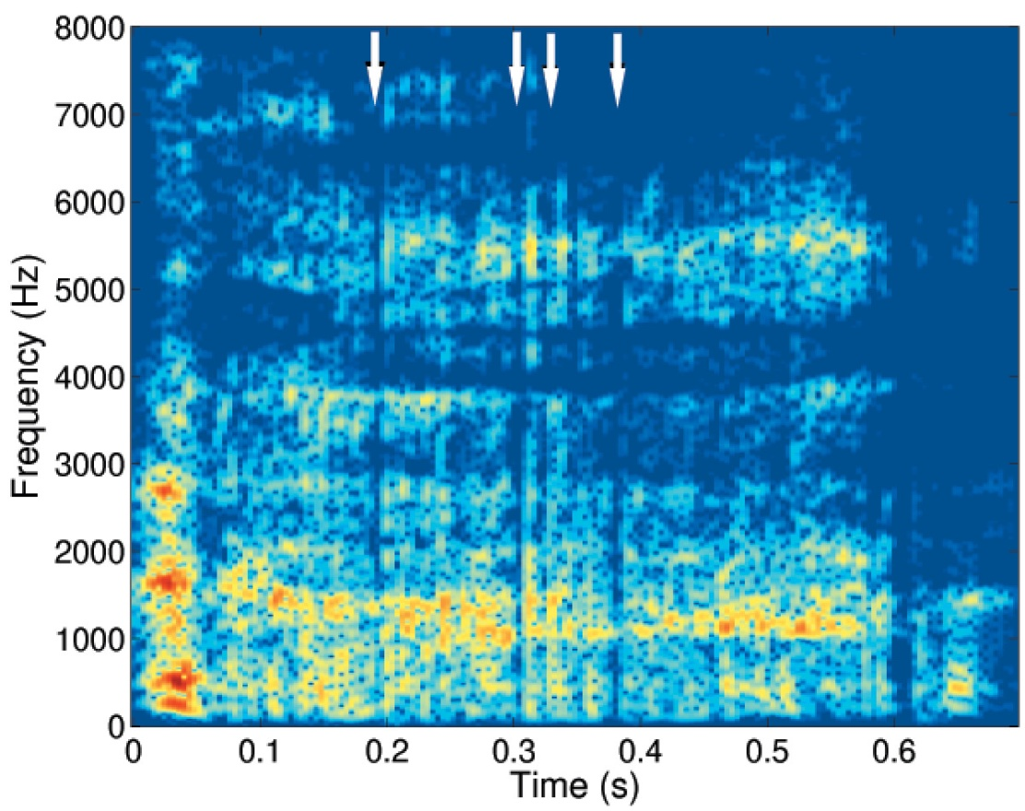
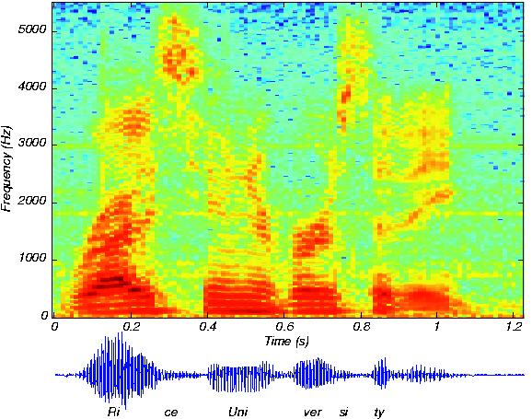

Slide 5
Speech
Phonetics – acoustic detail of speech sounds and how they are spoken
Phonology – sound categories each language uses

Slide 6
Phonology
Aspirated – sound that is made with breath (pin)
Unaspirated – sound that is made without breath (spin)

Slide 7
Phonology
Phonemes are the basic unit of sound
What are some basic phonemes in English?

Slide 8
Phonology
Phonemes
Allophones – variations of phonemes, different ways to say the same phonemes
For example, the L-R problem:
http://www.youtube.com/watch?v=46WcFObgYhI

Slide 9
Phonology
Phonemes
Minimal pairs – two words in a language that differ by one sound (cave, wave)
These pairs become important later when we talk about dyslexia…

Slide 10
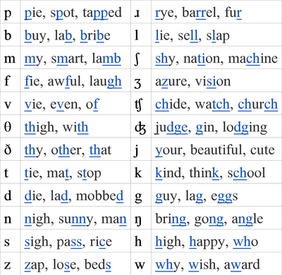
Phonology
International Phonetic Alphabet - standard way of representing phonemes
http://www.phonetics.ucla.edu/course/chapter1/chapter1.html

Slide 11
Phonology
Why would we use this?
Many to many problem
Not a one to one correspondence between sounds and symbols

Slide 12
Phonology
American and British English
http://www.youtube.com/watch?v=9IzDbNFDdP4
Received pronunciation – Queen’s English

Slide 13
Phonology
Dialects
Describe all the accents you think of in English
What causes them?

Slide 14
Phonology
General American – accentless speech where you can’t tell where a person is from.
Used by South Western Bell to record phone sayings
Where in the US would you say that accentless speech is from?

Slide 15
Phonology
Midwest – Illinois, Nebraska, Iowa
Where’s Colbert from?
South Carolina – says he worked hard to eliminate his accent because of the portrayal of Southerns as stupid on American TV.

Slide 16
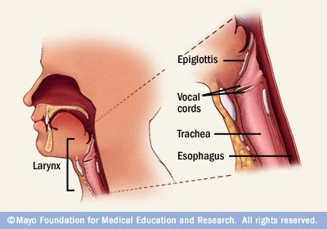
Phonology
Larynx – voice box

Slide 17
Phonology
Vowels – a e I o u
Are made by modifying the vocal tract
Generally with your mouth open
For example, B cannot be pronounced with an open mouth.

Slide 18
Phonology
Vowels – differences in vowels are created with the shape of the tongue
Dipthongs – two vowel sounds combined
Oy! Ay!

Slide 19
Phonology
Consonants – made by closing or restricting some part of the vocal tract (p b t d k g)
Usually have to make with a vowel sound (bee)

Slide 20
Phonology
Ways to classify consonants:
Voiced versus non-voiced – consonants produced with the vibration of the vocal chords
Place of articulation – place in the vocal tract that is close to articulate the word

Slide 21
Phonology
Articulation places:
Bilabial – using the lips (p sounds)
Alveolars – ridge behind and above your teeth (tea)
Dentals – tongue on the back of your teeth (the)

Slide 22
Phonology
Articulation places:
Labiodentals – lower lip to the top of the teeth (fff)
Postalveolar – tongue on the roof of your mouth behind the ridge on the palate (she/vision)

Slide 23
Phonology
Articulation places:
Palatal – tongue to the middle of the palate (you)
Velars – all tongue to the soft palate (very back of the mouth) – (get)

Slide 24
Phonology
Sounds with out the tongue:
Voiceless glottal fricative – h sounds (hit him)
Glottal stop – sound produced by closing and opening the glottis
bottle (tends to be a hard sound)

Slide 25
Phonology
Voicing – the manner of articulation – way in which the airstream is constricted in speaking

Slide 26
Phonology
Voicing
Stops – complete interruptions in airflow (t)
Fricatives - formed so that air rushes through with a hissing sound (f)
Affricatives – combination of brief stop followed by a constriction (cheese)

Slide 27
Phonology
Voicing
Liquids – air flow around the tongue (l and r)
Nasal – flows through nose cavity
Glides or semi-vowels – transitions as we move from one vowel to another (way)

Slide 28
Phonology
Higher level sound structures
Syllables – rhythmic unit of speech
Onset – Initial consonant or cluster
Rime – end part of a word that produces the rhyme (vc or vcc)
Rant, r-ant

Slide 29
Phonology
Syllables are stressed differently, but in English they all have the same time, so we are a stressed time language
Em-pha-sis on the wrong sy-lab-ble
http://www.youtube.com/watch?v=7FQESCVkXnU (very end of clip)

Slide 30
Linguistics and Syntax
Chomsky – language is innate, species-specific, and biologically pre-programmed
Grammar – set of syntactic rules of language

Slide 31
Linguistics and Syntax
Chomsky
Competence – our knowledge of our language
Performance – our actual language ability, limited by our cognitive capacity

Slide 32
Linguistics and Syntax
Grammar – Minimalism
Generative grammar – a finite set of rules that will produce or generate all the sentences of a language, does not generate non-sentences
Notes:
Also needs to explain how we know that sentences are related (I went to the store and bought an apple, this apple was bought yesterday by me at the store)
And how children acquire the rules

Slide 33
Linguistics and Syntax
Phrase – structure rules – describe how words can be combined, sentences are created in a hierarchical fashion with rewrite rules
Notes:
Terminal elements – consisting of words
Nonterminal elements – everything else

Slide 34
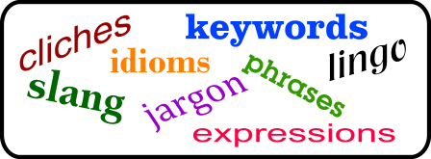
Linguistics and Syntax
What are the types of words?

Slide 35
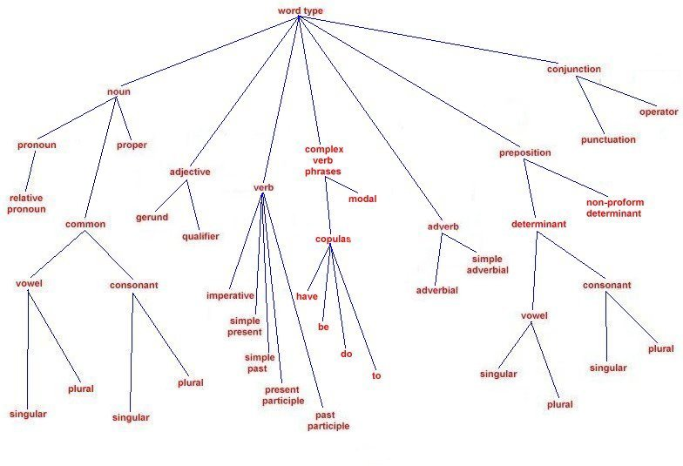
Linguistics and Syntax

Slide 36
Linguistics and Syntax
Nouns – can act as names, and can be subjects or objects of a clause, all things are nouns
Adjectives – describing words
Verbs – words that express actions, events and states, which have tenses

Slide 37
Linguistics and Syntax
Adverbs – word that modifies a verb
Determiners word that determines the number of a noun (the a some)
Prepositions – word expressing a relation (to with from)

Slide 38
Linguistics and Syntax
Conjunctions – connects words within a sentence (and because)
Pronouns – words that can stand for nouns (she he it)

Slide 39
Linguistics and Syntax
Content words – words that convey most of the meaning in a sentence
Basically the words you need to understand the sentence
Function words – words that do the grammatical work of the language

Slide 40
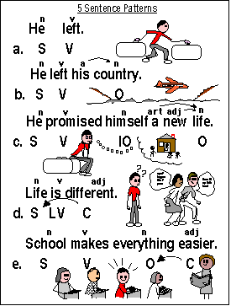
Linguistics and Syntax
Sentence
structure

Slide 41
Linguistics and Syntax
Phrases – group of words forming a grammatical unit beneath the level of a clause
Noun phrase – grammatical phrase based on a noun
Verb phrase – grammatical phrase based on a verb

Slide 42
Linguistics and Syntax
Clauses – group of related words containing a subject and a verb
Subject – the word or phrase that the sentence is about
Predicate – the part of the clause that gives information about the subject

Slide 43
Linguistics and Syntax
Constituents – a linguistic unit that is part of a larger linguistic unit
Objects – a person thing or idea that is acted on by a the verb

Slide 44
Linguistics and Syntax
Verb types
Transitive verbs – a verb that takes an object
Intransitive verbs – a verb that does not take an object
Ditransitive verbs – a verb that requires an direct and indirect object

Slide 45
Linguistics and Syntax
Modifiers – a part of speech that is dependent on another, modifies or qualifies in some way (the vampire with a lisp)

Slide 46
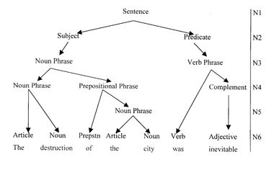
Linguistics and Syntax
Tree diagrams – can create a diagram of the sentence structure to understand the relationship between items in a sentence (underlying grammar)

Slide 47
Linguistics and Syntax
Break down this sentence:
This sentence is boring.
Colored pencils were used by the teacher.

Slide 48
Linguistics and Syntax
Active versus passive
Active – the subject of the sentence is doing the action of the verb
Passive – the subject of the sentence is not doing the action of the verb

Slide 49
Linguistics and Syntax
Ways we create sentences:
Recursion – I know that I know that I know …
Iteration – I had ice cream and I ate ice cream and I love ice cream.
Transformations – a grammatical rule for transforming one syntactic structure into another (i.e. going from active to passive, or changing into a question)
Notes:
Recursion – our ability to create sentences is infinite, but the number of rules in a grammar is limited…
Rule that uses a version of itself in its definition
I know that he knows that I know.
Iteration – grammar allows us to carry on repeating rules to create sentences
I had ice cream and I ate ice cream and I love ice cream.
Transformations -
Phrase structure grammar cannot explain the relationship between sentences, although it does explain sentence creation.
Transformations – a grammatical rule for transforming one syntactic structure into another (i.e. going from active to passive, or changing into a question)
Transformational grammar – a system of grammar based on transformations

Slide 50
Linguistics and Syntax
Chomsky’s theory of Transformational Grammar:
Semantic system – assigns meanings to the syntactic strings
Phonological – how we pronounce things
Syntax – rules (phrase – structure rules), and transformations

Slide 51
Linguistics and Syntax
Chomsky:
Deep structure – the meaning of a sentence – part of semantic system and syntax
Surface structure – the actual words, part of the transformation rules and phonological rules
Using this distinction can help explain ambiguous sentences

Slide 52
Linguistics and Syntax
Is innate Chomsky the only answer?
Cognitive linguistics – language is part of our general cognitive system.

